Slide 1


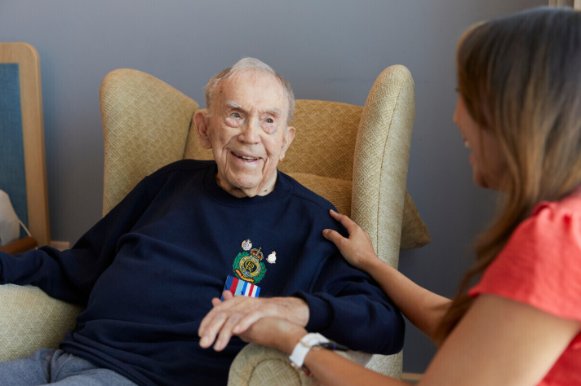

Head of Fundraising – Central Services
Candidate information pack

Slide 2

Welcome to Royal Star & Garter
The role at a glance
Title: Head of Fundraising
Location: Hybrid working with regular attendance at Twickenham
Reports to: Director of Supporter Engagement
Hours: F/T – 35 hrs pw
Salary: £62,000
Dear Candidate,​
​
Thank you for your interest in joining Royal Star & Garter as our new Head of Fundraising. This is an exciting opportunity to lead a talented fundraising team and play a central role in delivering our ambitious fundraising strategy at a pivotal moment.​
​
Over the coming years we will expand our reach beyond our Homes, grow community-based services, strengthen the Veteran Friendly Framework, and support more veterans and their families than ever before. Fundraising will be critical to making this vision a reality. We are looking for an inspiring leader who can grow income, attract new supporters, develop compelling cases for support and build lasting relationships that help sustain our mission.​
​
Reporting directly to me as Director of Supporter Engagement, you will lead supporter growth, and fundraising performance across multiple channels. You will help shape how we engage new audiences, use data and insight to improve supporter journeys, and ensure every fundraising activity reflects the stories, needs and experiences of veterans and their families.​
​
If you are motivated by combining strategic leadership with practical delivery and are excited by the opportunity to help shape the next chapter of Royal Star & Garter's development, I would be delighted to hear from you.​
​
Caley Eldred​
Director of Supporter Engagement

Slide 3
Job description
To apply
Send your CV and a covering letter (no more than two sides) outlining how you meet the person specification to:
Eddie Taylor: eddie@charitybegins.org
Please include any paid or voluntary experience that you think might be relevant and ensure that you tell us what you will bring to the role.
Lead delivery of the fundraising strategy through annual plans, campaigns and activity
Be accountable for delivery of annual fundraising targets and performance
To drive donor and supporter acquisition with a focus on data and insights, enabling seamless journeys
To provide strong leadership and support to the team of fundraising managers – delivering high-impact, compliant and ethical fundraising activity.
Purpose
Leadership
Lead delivery of the fundraising strategy through annual plans, campaigns and income-generation programmes
Identify and scale opportunities to reach new supporters, including digital channels, direct marketing, partnerships, and campaigns
Align core fundraising activity with the five-year fundraising and brand strategies
Deliver compelling cases for support that demonstrate clear impact and that honour and root story telling in the voices of veterans and their families
Monitor fundraising and audience trends, particularly in acquisition and supporter engagement.
Income generation
Oversee all income streams, delivering associated annual targets and managing performance across all fundraising products, channels and segments
Drive cold acquisition activity across activity and channels with a focus on ROI and lifetime value, generating a pipeline of new donors and helping develop strategies to convert them into long-term supporters.
Key responsibilities

Slide 4
Job description - continued
We anticipate this role will be hybrid, minimum one day per week in our Twickenham Office & visits to our Homes and other new sites.
For an informal conversation on the role please contact Eddie Taylor
Performance, finance and risk monitoring
Design, implement and manage fundraising performance frameworks, dashboards, risk registers and reporting, maintain effective controls and reviews
Ensure fundraising activity is monitored against appropriate KPIs
Ensure day-to-day compliance with fundraising regulation, GDPR and internal policies
Oversee core budgets, monitor income & expenditure forecasting, and performance reporting
Ensure robust use of data, CRM systems, and insight to optimise acquisition and retention strategies.
Management
Line manage, support, coach and develop the fundraising managers, helping to support their wider teams, setting clear objectives aligned with income and acquisition targets
Build team capability in acquisition techniques, data-driven fundraising, and supporter journeys
Foster a collaborative culture with a focus on effective cross-team planning
Personally manage relationships with agreed funders, partners, and high-value prospects
Work effectively upwards and across with the Director of Supporter Engagement and other members of the senior leadership teams.
Other:
Undertake regular travel to attend events, meet partners, and engage with regional teams and locations of current and new service delivery
Occasional evening and weekend work may be required
Any other duties that may be agreed – on the basis of a sensible assessment of workload and which remain consistent with the nature of the role.
Key responsibilities

Slide 5
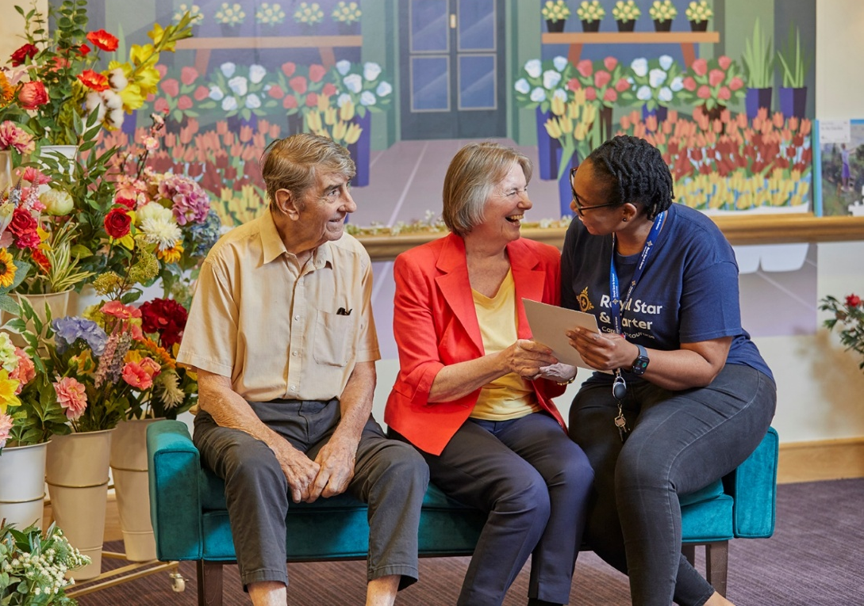
Person specification
Knowledge and experience:
Significant experience in a senior fundraising role with responsibility for substantial income targets (ideally £3m+)
Proven track record in donor acquisition and supporter growth, including digital and/or direct marketing channels
Experience in managing and developing high-performing teams
Demonstrable success in delivering multi-channel fundraising plans
Knowledge of fundraising regulations and standards.
Skills:
Strong expertise in acquisition strategy, supporter journeys, and lifetime value optimisation
Excellent understanding of data-led fundraising and performance marketing
Strong financial and commercial acumen, with experience of managing budgets
Excellent relationship-building and influencing skills.
Personal characteristics should include:
Passion for supporting veterans and an understanding of the issues affecting the Armed Forces community
Innovative, proactive, and results-driven mindset
Planning and organising; schedules activities effectively
Effective team player and role model – centring our values in all aspects of work.

Slide 6
With love
Living positively
Our values
We carry out our work with love, care and compassion.
We are optimistic in everything we do, supporting veterans and their families in leading happy, fulfilled lives.
As a family
Standing in their shoes
Take courage
We work and live as one team, one family, one community.
We show admiration and respect for people and never forget what they have done.
We are not afraid to do what is right and what is needed.

Slide 7
Offer
Although we are a charity, we offer a generous package
Ten weeks full occupational sick pay before statutory sick pay
Access to appropriate professional bodies and payment of relevant membership fees after six months of employment
Learning and development – opportunities to support you in your role
Salary of £62,000
35 hours per week – condensed working options available
Equivalent of five weeks holiday per annum plus bank holidays (pro-rata for part-time)
Employer Pension Contribution of 7.5% with matching Employee contribution of 5%
Life insurance of three x salary (until age 70)

Slide 8
Conditions of employment
Any offer of employment made will be subject to the following conditions:
Satisfactory references covering the last 5 years from at least two references, including one from your current or most recent employer
A pre-employment medical screening
Enhanced DBS Disclosure
Proof of the Right to Work in the UK
Confirmation in post will be subject to:
A satisfactory 6-month probationary period.

Slide 9
About us
Our mission
Royal Star & Garter was founded in 1916 to care for the severely injured young men returning from the battlegrounds of the First World War. Today, our mission is to provide outstanding care and support that recognises the needs of veterans and their families.
Our care
We provide care, support and friendship for those who have had the courage to serve so that they can live well. We deliver that through high quality Homes, a range of services in the local community, by driving innovative practice and by setting the standards for others to follow. We offer:
Nursing care
Dementia care
Short-break/respite care
End of life care
Day care
Lunch Clubs
Telephone Friendship Service

Slide 10
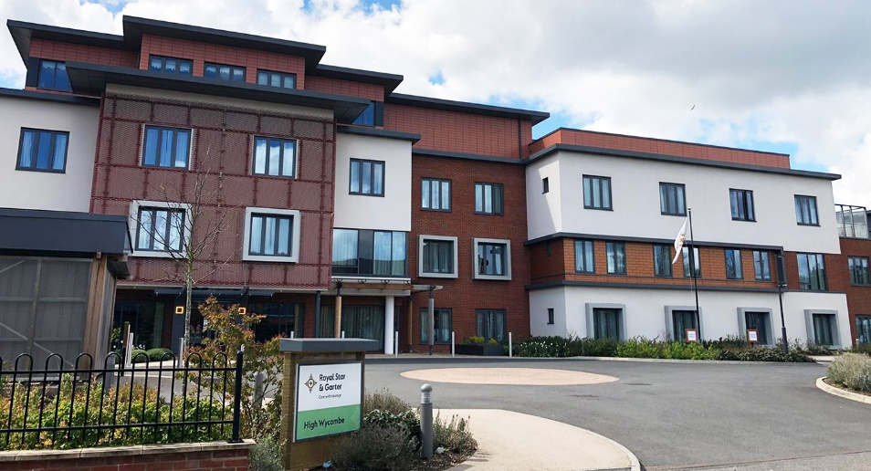

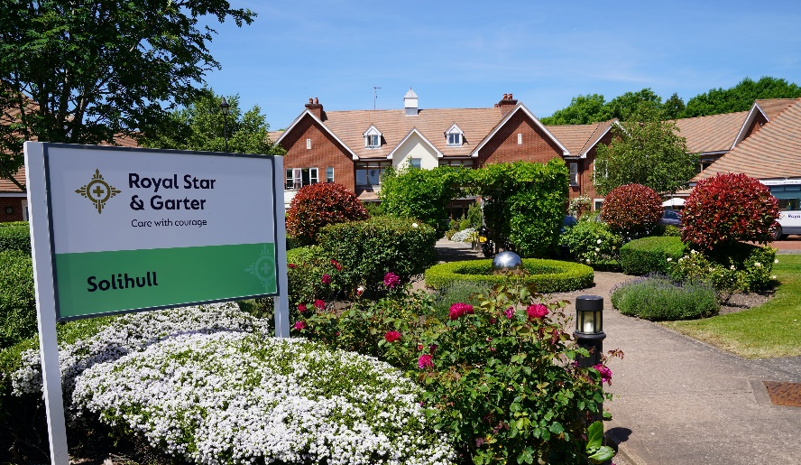
High Wycombe
Our High Wycombe Home (rated Outstanding by the CQC) has been designed with comfort and wellbeing in mind. There are plenty of activities to enjoy, opportunities to socialise with friends, or simply relax in the spacious lounges and landscaped garden.
Solihull
Our Solihull Home is rated Outstanding in all five areas by the Care Quality Commission. Loving, compassionate care is tailored to each individual and every detail designed for comfort and wellbeing, it’s a place where residents and their families can truly feel at home.

Slide 11
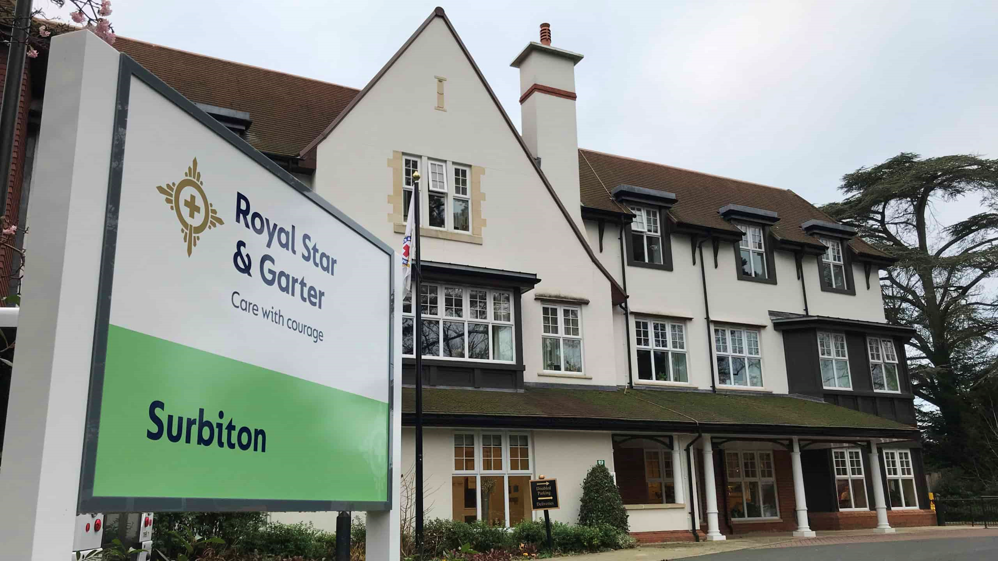

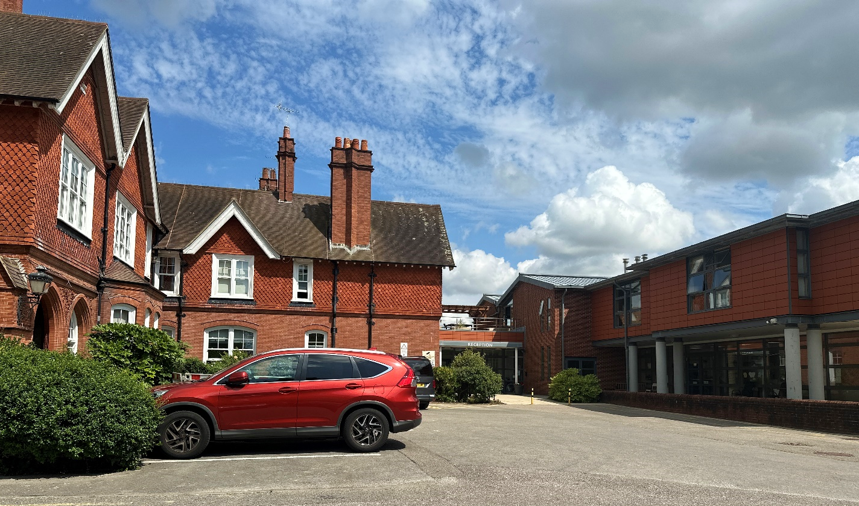
Surbiton
With its stunning foyer and relaxed, spacious lounges, our Surbiton Home offers a warm, friendly welcome. Highly trained staff provide specialist care in comfortable surroundings, where the focus is always on the individual.
And rated ‘Outstanding’ in the care category.
Worthing
Our Worthing Home places each person at the heart of their care, with personalised rehabilitation plans that promote independence, confidence and wellbeing.
The dedicated team includes in-house physiotherapists, occupational therapists and speech and language therapists who offer hands-on support with warmth and encouragement.

